Slide 1

Mechanical Design Methods
First Assignment Report (Group 8)
Students
Lorenzo Baccelliere S2621588
Mattia Piras S4524072

Slide 2
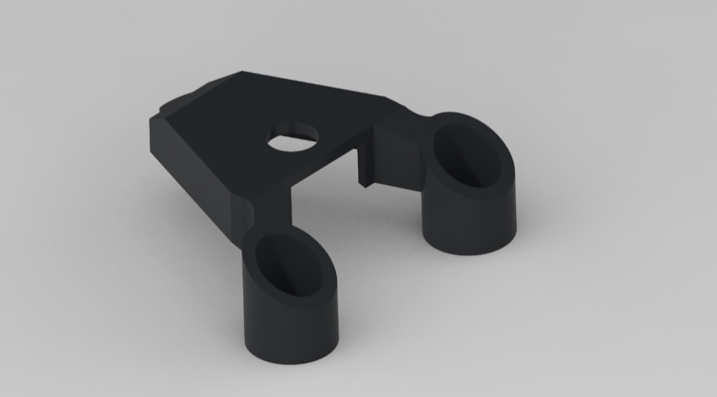
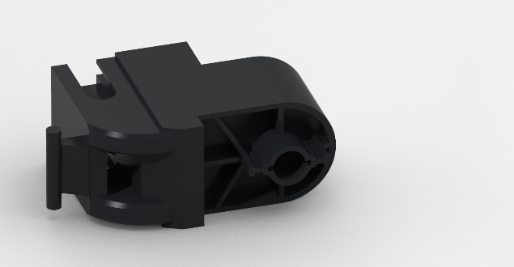
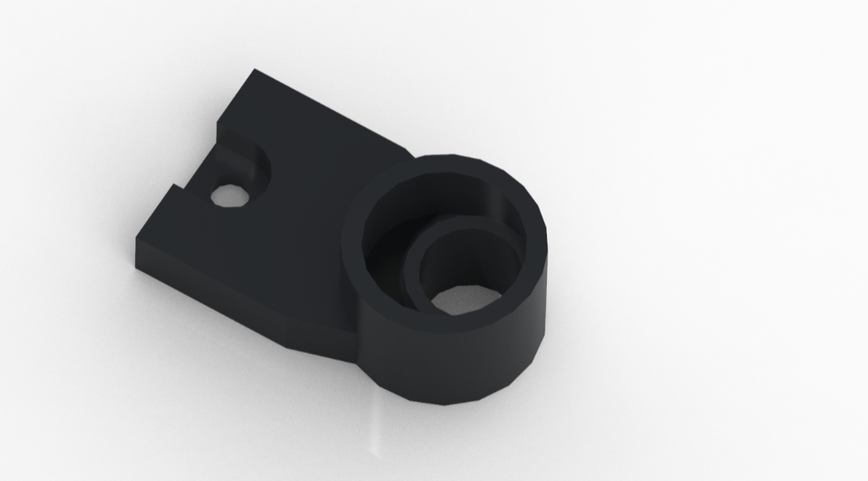
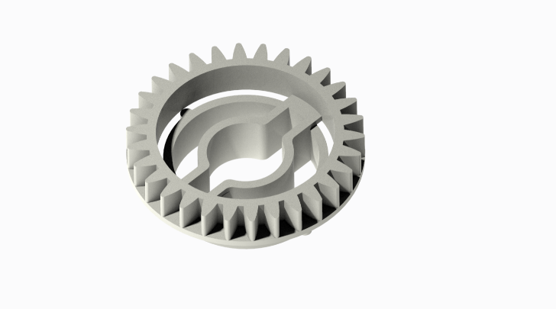
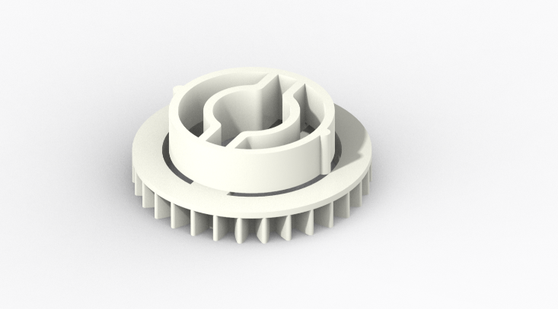
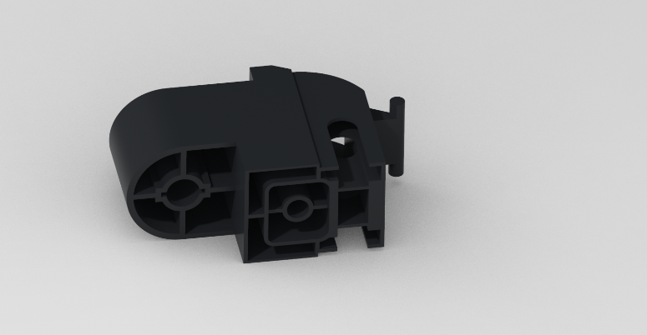
1/4 Part modeling
Part measures detection
Mechanical interfaces recognition (instruction manual reference)
Modeling paradigms:
- Lowest possible number of feature
- Easy accessibility to measures related to mechanical interfaces
- Model refinement to replicate real part fabrication
C12
C14
C10
B2

Slide 3
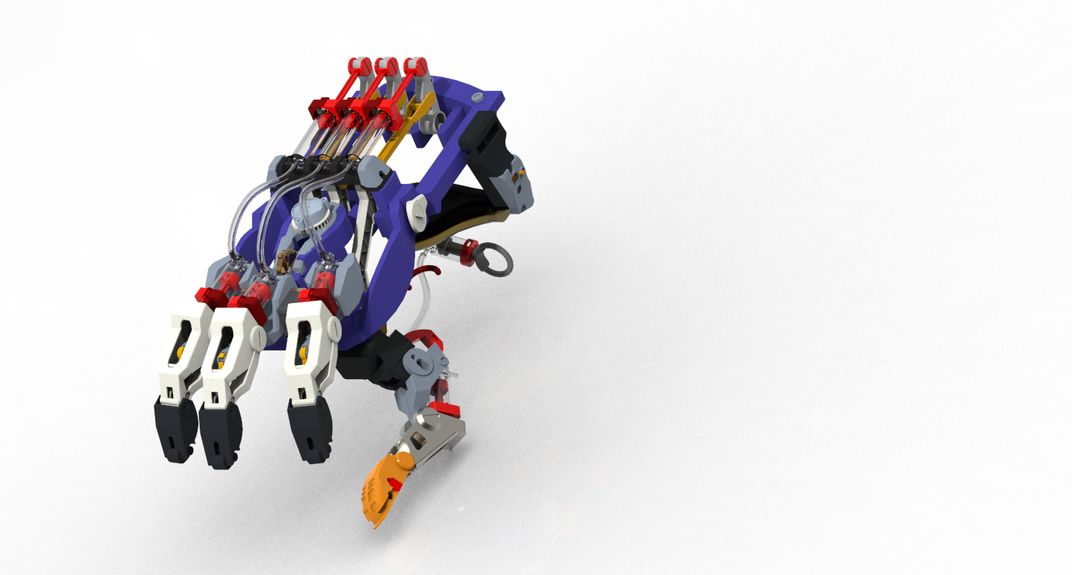
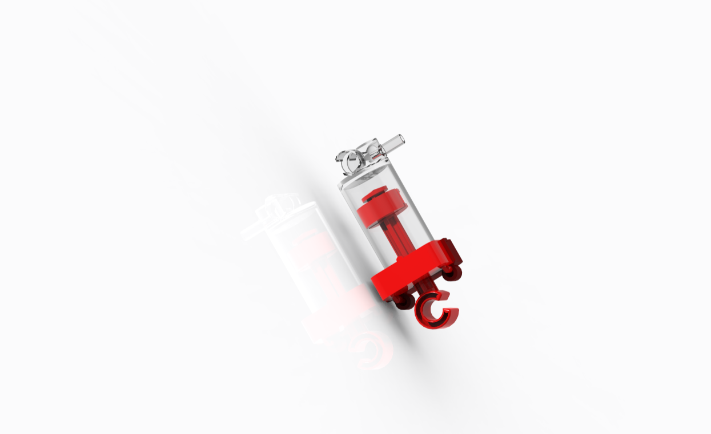
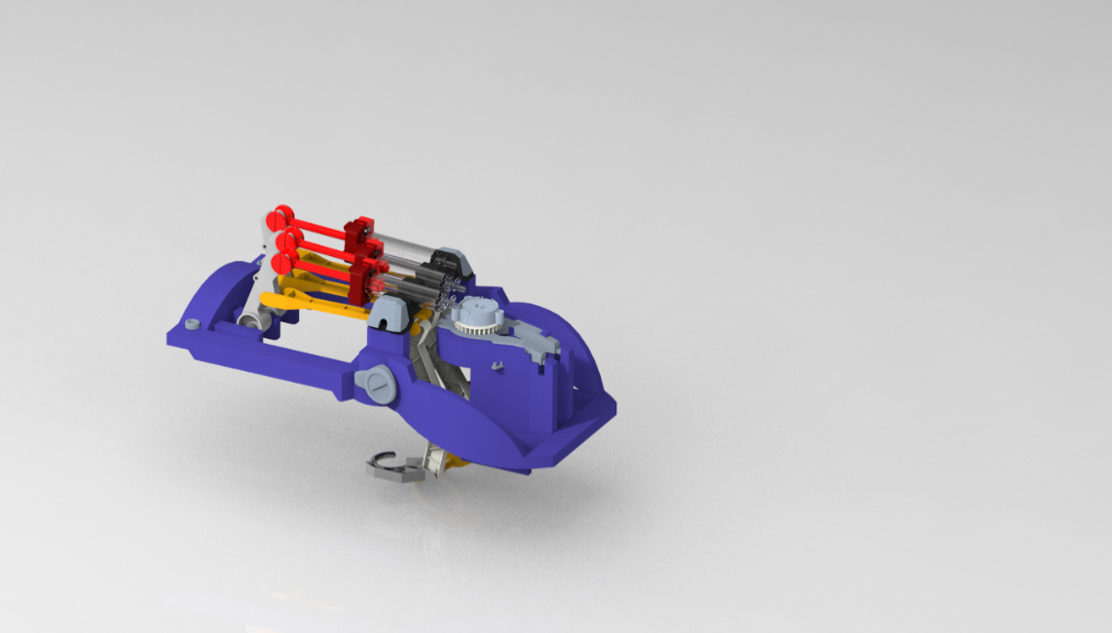
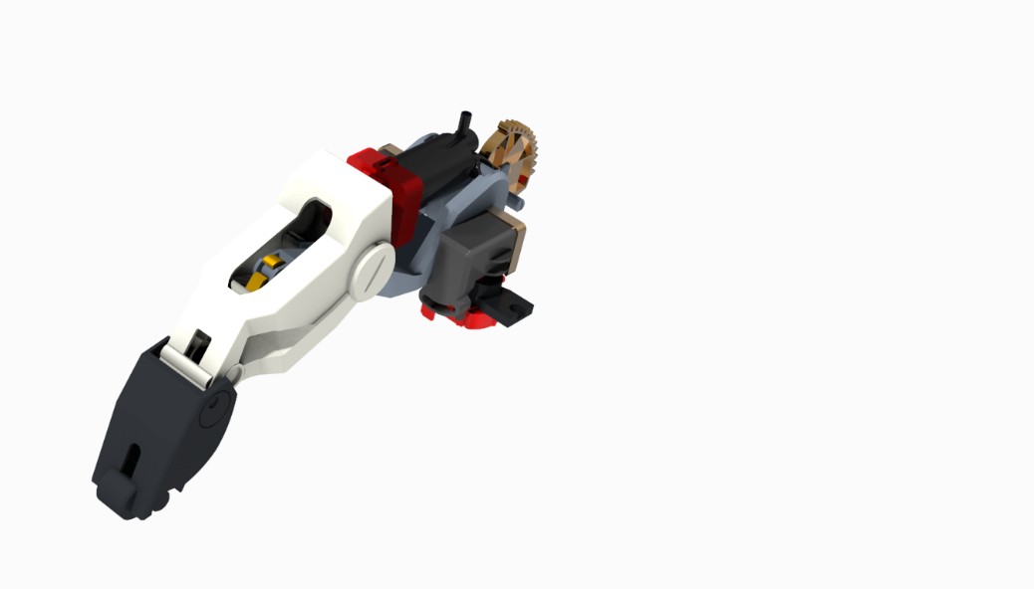
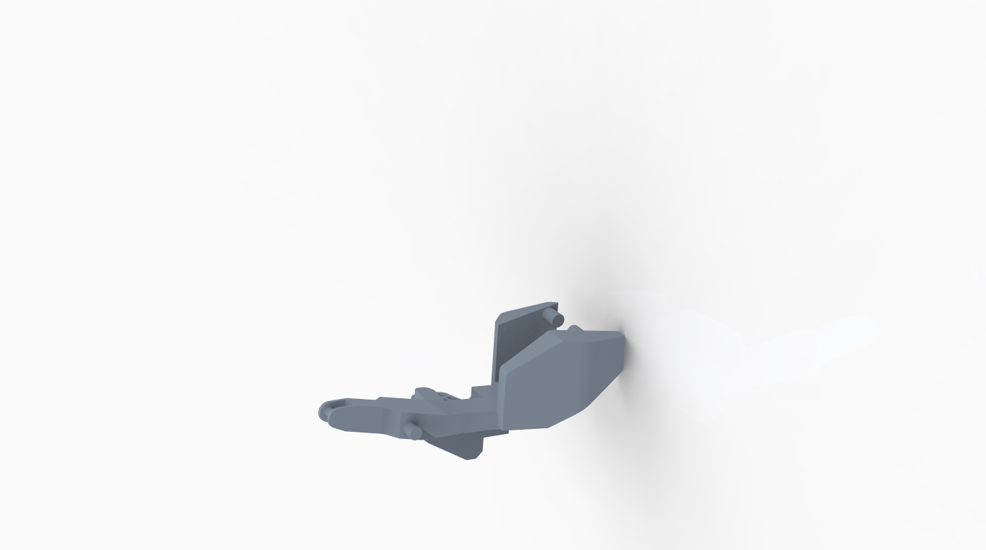
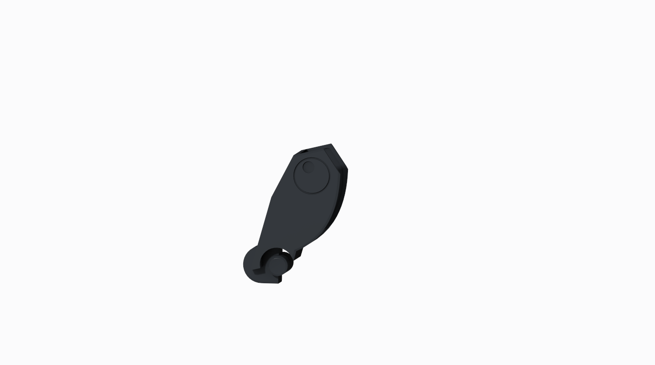
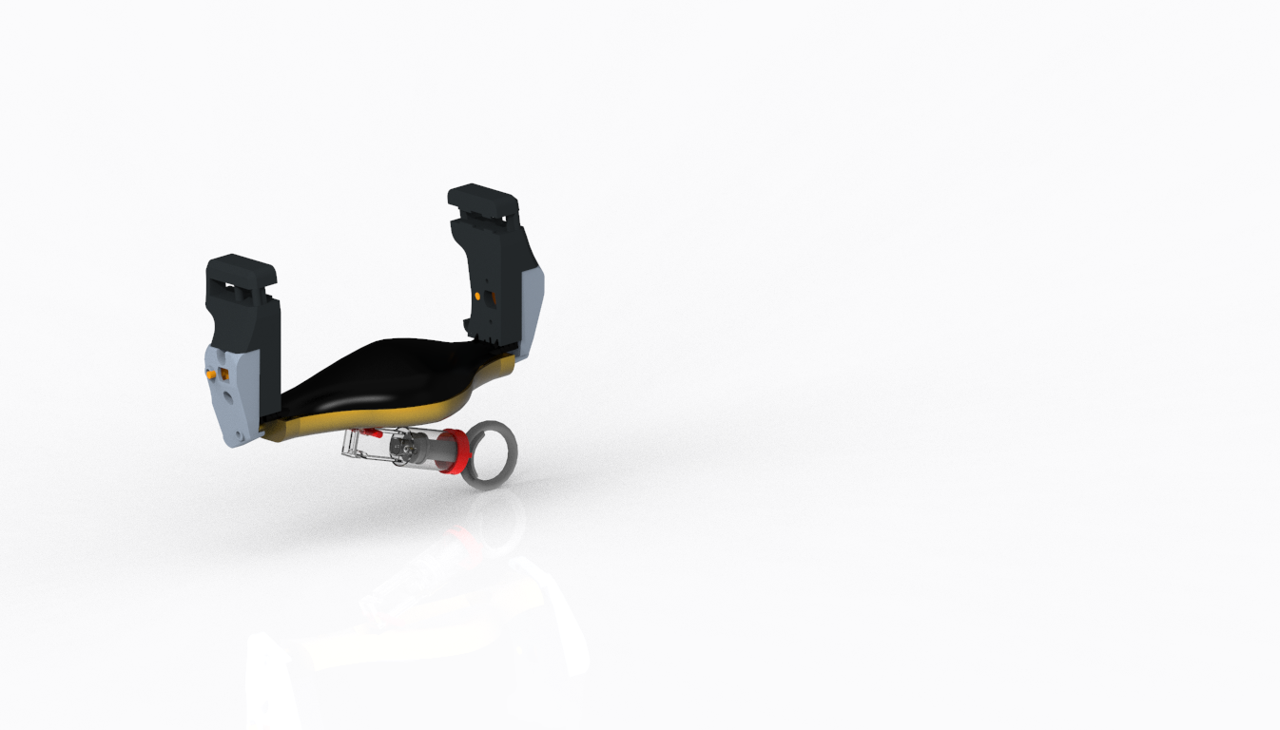
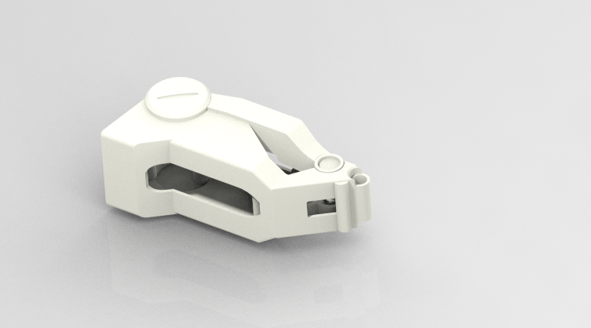
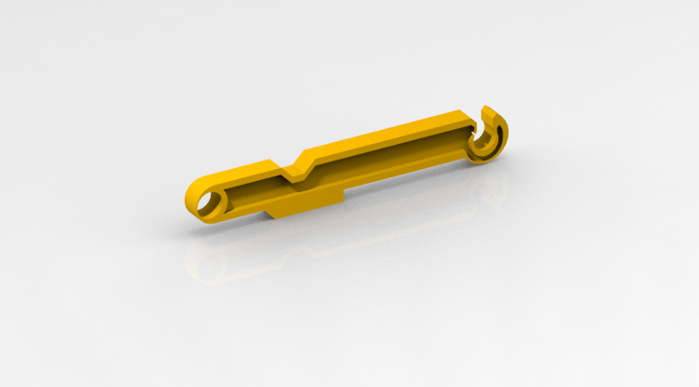
2/4 HAND Assembly Map
Top-down Approach : Assembly MAP (instruction manual reference)
……
…..
….
Single
parts
CHASSIS
PUMP
FINGERS
……
…..
….
CYBORG-HAND
PALM-REST
PHALANGES

Slide 4
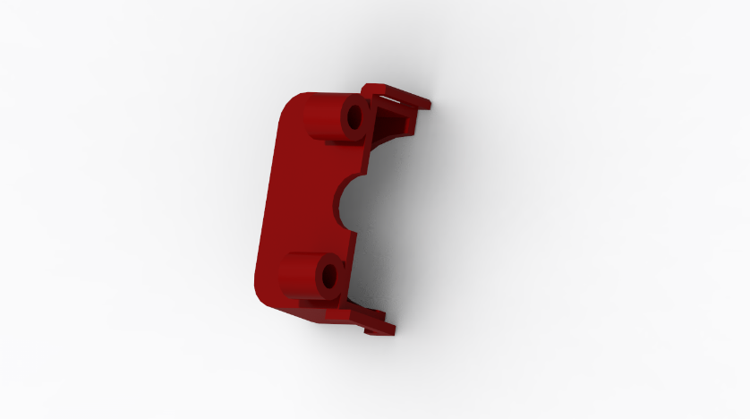
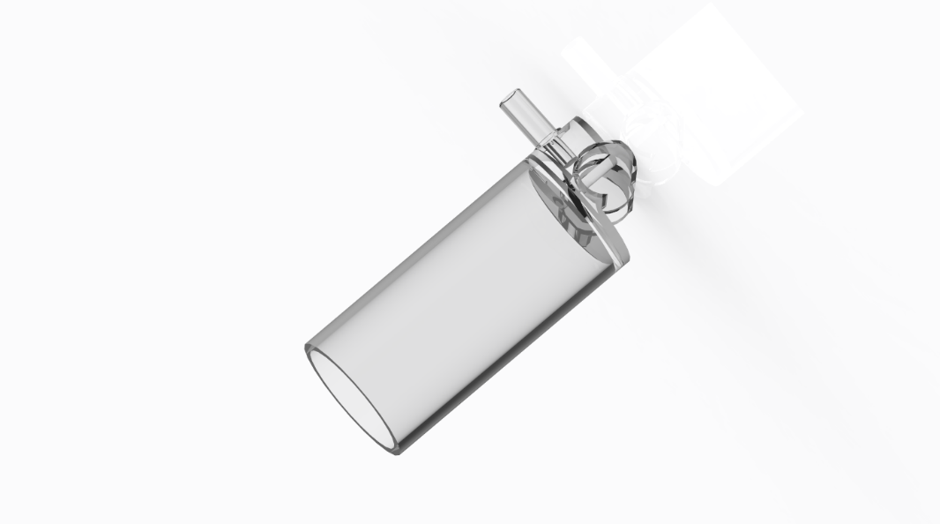
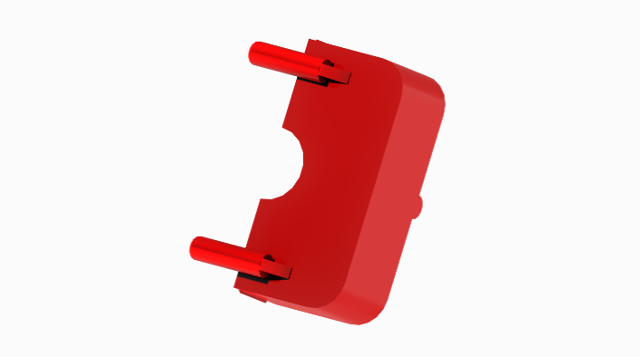
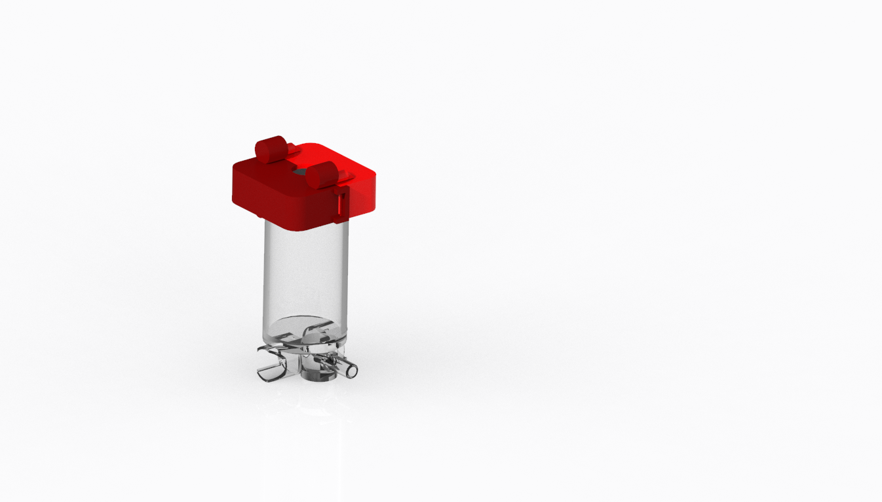
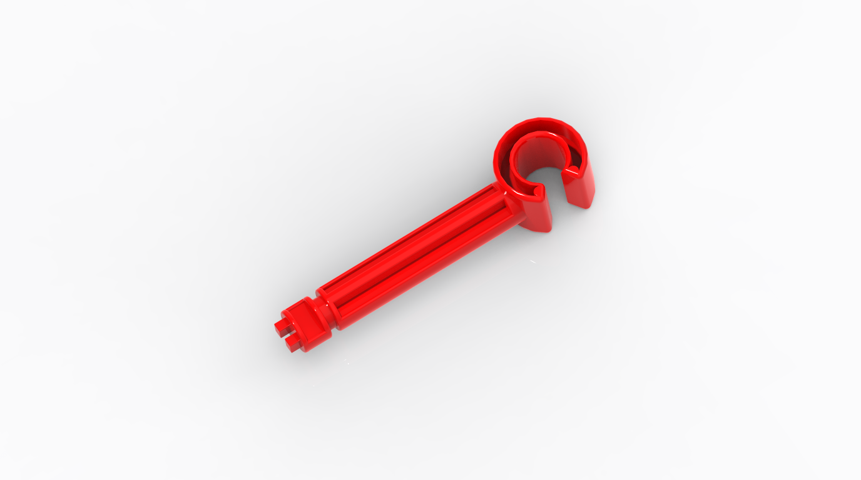



3/4 HAND Assembly building
Bottom -UP Approach : sub-assemblies’ construction
- Assembly of parts/sub-assemblies
- Definition of the constraints between parts/sub-assemblies
RIGID constraints
MECHANICAL constraints

Slide 5

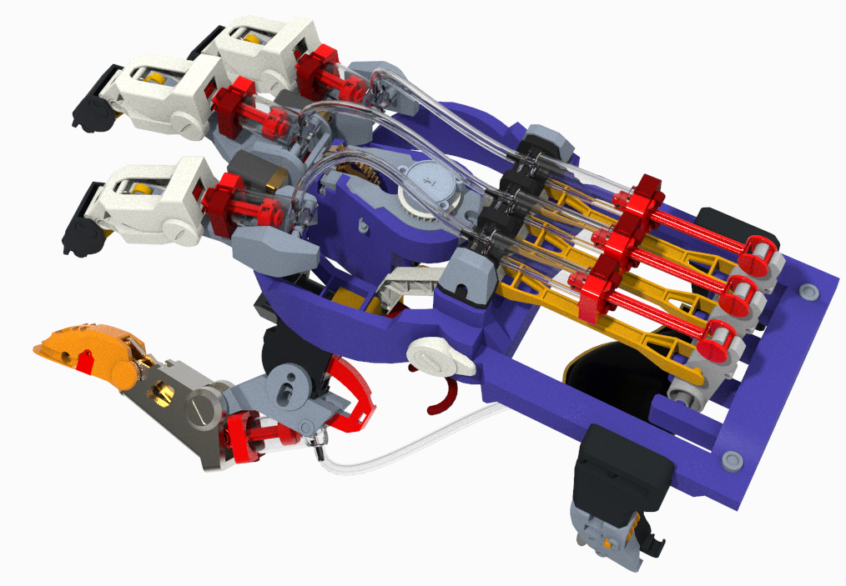
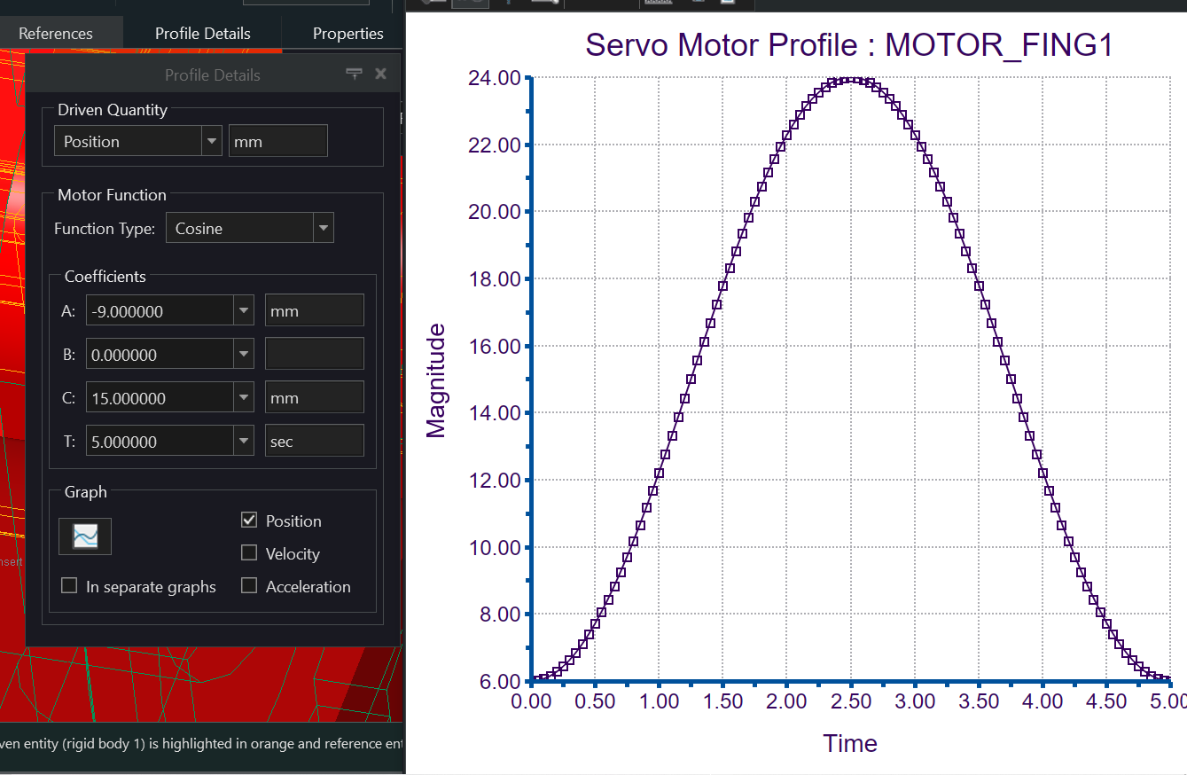
4/4 Mechanisms
Measure of feasible range of finger PUMP displacement (avoiding finger singularities)
Set finger driver Pump (mounted on chassis) with same stroke
Gear connection between drive pump and finger pump
Run Motor Position analysis
Finger
pump
1:1
Driver pump
MOTORIZATION FUNCTION
Driver
pump

Slide 6
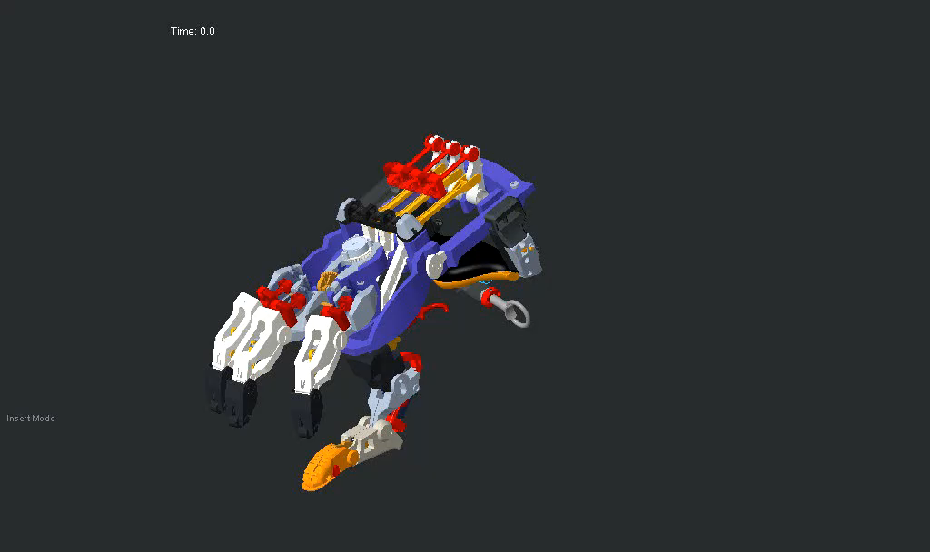
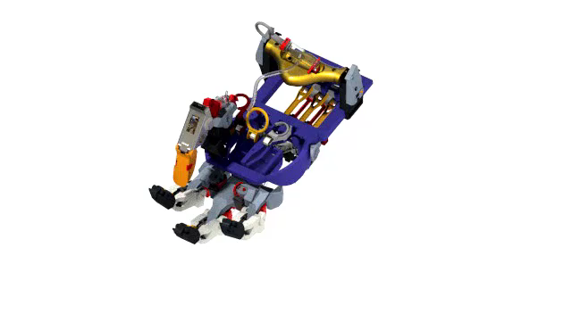
Thank you for your attention

